Slide 1
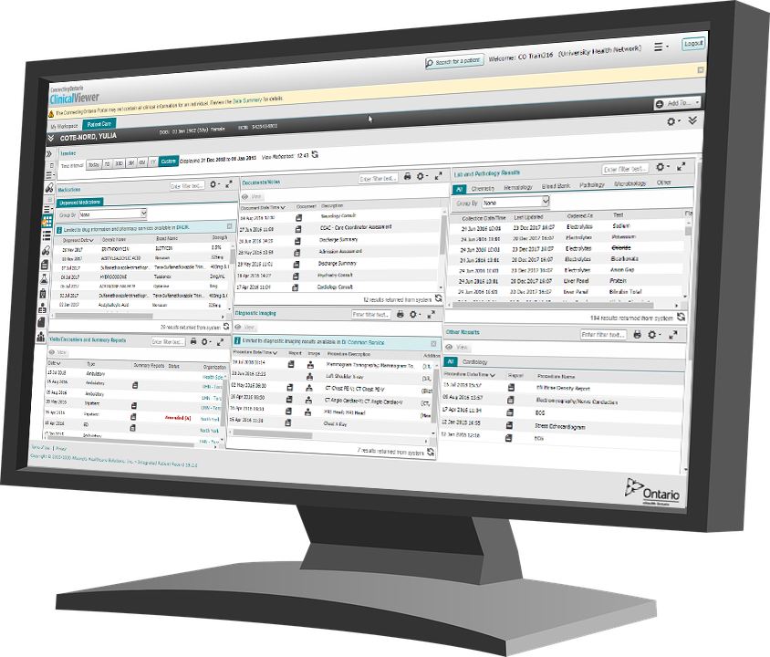
ConnectingOntario ClinicalViewer Training
march 2024
Notes:
Revised for Release 12 of the ConnectingOntario ClinicalViewer

Slide 2
Contents
  Slide Number
Logging In and Out 2
My Workspace 7
Patient Search 8
Parts of the Window 9
Patient Care Tab 10
Timeline 11
Navigation Bar 13
Portlets Overview 14
Medications Portlet *Mandatory Content 17
Diagnostic Imaging Portlet 28
Lab and Pathology Results Portlet 37
Consent Management 40
Available Training Resources 46

Slide 3
Accessing the ConnectingOntario ClinicalViewer
Using Single Sign-On
If your organization has single sign-on to the ConnectingOntario ClinicalViewer, you will be able to access the ClinicalViewer directly from your own hospital or clinical information system
As well, if patient context sharing is enabled, the patient you select from your information system will be maintained when you access the ConnectingOntario ClinicalViewer
Follow your organization’s policies and recommendations regarding single sign-on and patient selection
Note: You must only view records for patients for whom you are providing care for the organization you are logged in under (unless otherwise permitted by the organization)
ConnectingOntario ClinicalViewer Trainer’s Guide v14
March 2024
Notes:
Trainer note: include only if your organization uses single sign-on to access ConnectingOntario ClinicalViewer.
Auxiliary materials: existing login / information system documentation created within your organization

Slide 4
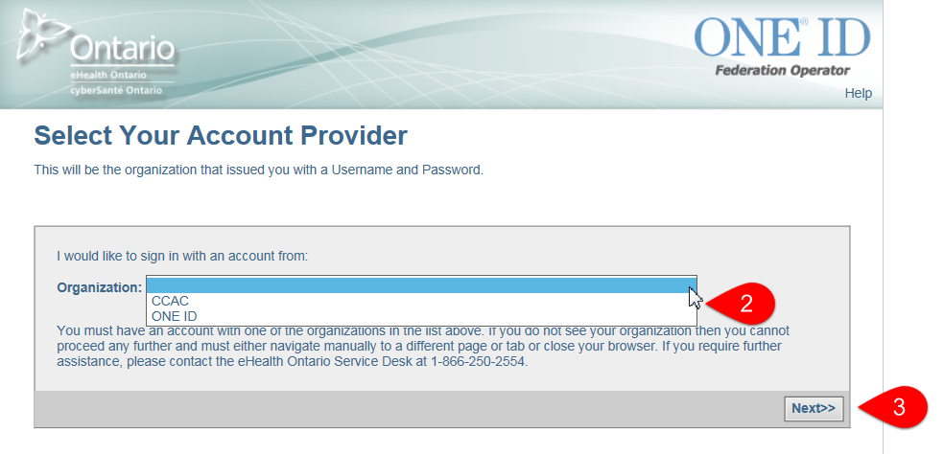
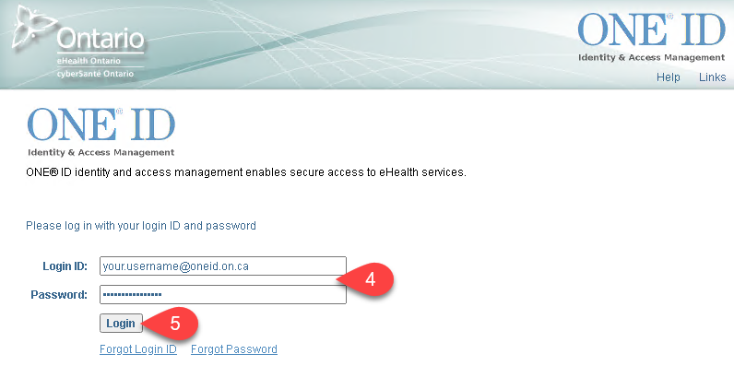
Accessing the ConnectingOntario ClinicalViewer
Using ONE® ID
To access the ClinicalViewer with your ONE ID credentials:
Go to https://portal.connectinggta.ca/pe/p/ql
Select “ONE ID” from the drop down list
Select Next
Enter your login ID and password
Select Login
ConnectingOntario ClinicalViewer Trainer’s Guide v14
March 2024
Notes:
Trainer note: include only if your organization uses ONE ID and the ConnectingOntario portal to access ConnectingOntario ClinicalViewer

Slide 5
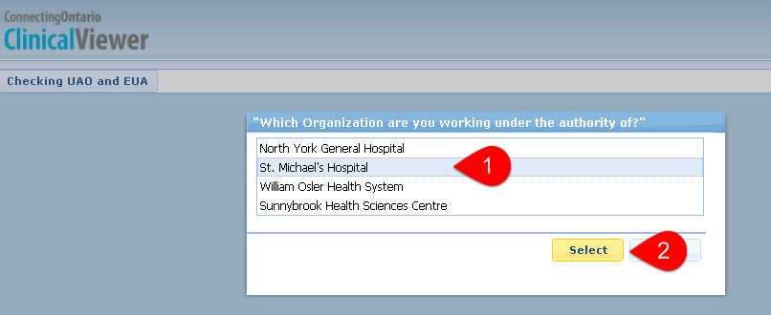
Accessing the ConnectingOntario ClinicalViewer
Using ONE® ID (continued)
The ClinicalViewer opens in a new browser window.
If you are authorized to access the ClinicalViewer under more than one authority, and through the same user account (i.e., ONE ID), a pop-up window displays, prompting you to select an organization.
* This window displays only under this circumstance.
To select the organization under whose authority you are working:
In the drop down list, select the name of the organization
Click Select
Note: You must only view records for patients for whom you are providing care for the organization you are logged in under (unless otherwise permitted by the organization)
ConnectingOntario ClinicalViewer Trainer’s Guide v14
March 2024
Notes:
Trainer note: applies to ONE ID access method only

Slide 6




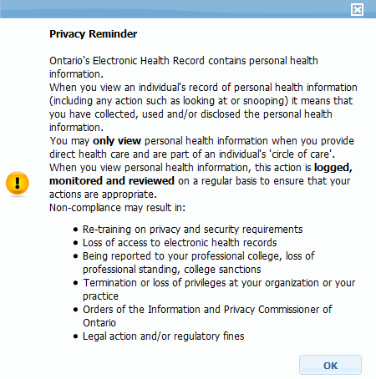
End User Agreement
The first time you access the ClinicalViewer and on the first access of each new calendar year, you must accept this agreement
To accept the End User Agreement:
Select OK
  The End User Agreement displays
Scroll through and review the agreement
Select Accept, then select Submit
A privacy reminder displays on your first log in of the day and no more than once in every 24 hours
As learned in the Privacy and Security training, you have a legal obligation to protect the privacy of patient information
ConnectingOntario ClinicalViewer Trainer’s Guide v14
March 2024
Notes:
Trainer note: applies to both single sign on and ONE ID methods of accessing the ClinicalViewer

Slide 7


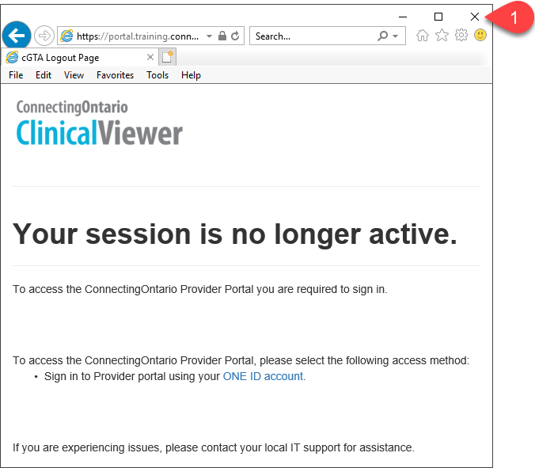
Exiting the ConnectingOntario ClinicalViewer
It is best practice to log out after each use of the ClinicalViewer and before leaving the workstation
To log out of the ClinicalViewer:
Select Logout and close the browser window
Both of these actions are required to comply with Privacy and Security legislation
Note: You are limited to using a single instance of the ClinicalViewer at any time
ConnectingOntario ClinicalViewer Trainer’s Guide v14
March 2024
Notes:
Trainer note:
The ClinicalViewer automatically logs out users:
after fifteen minutes of inactivity
if you navigate away from the ClinicalViewer without logging out. (The log out page displays if you use the Back button)
The DI Image Viewer window also times out after 15 minutes of inactivity, but this happens separately from the time out for the ClinicalViewer
Therefore, if you have not closed the Image Viewer’s browser window and the ClinicalViewer window times out, the Image Viewer window may still be active until you close it’s window as well

Slide 8
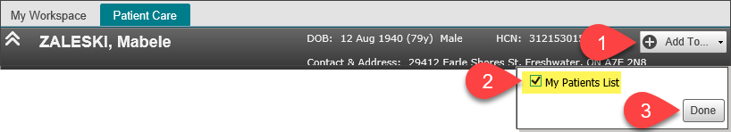
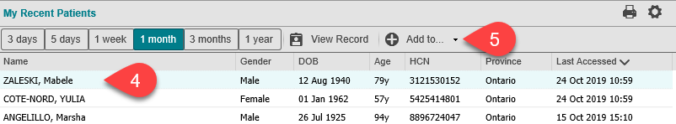
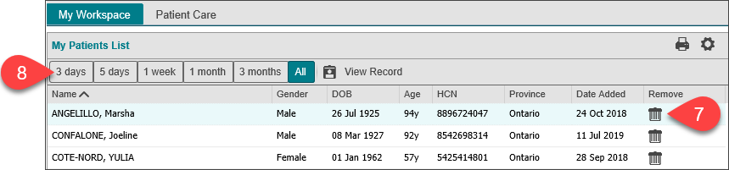
My Workspace
My Workspace contains two distinct patient lists: My Patients List and My Recent Patients
My Patients List: a customizable list to which you can add/remove patients
My Recent Patients: automatic list composed of patients you have viewed within the last 365 days
To add a patient to My Patients List from:
Patient Care tab
  Select Add To
  Check the “My Patients List” box
  Select Done
My Recent Patients
Select the patient to be added
Select Add To
Select My Patients List (not shown)
To remove a patient from My Patients List:
In the row of the patient to be
removed, select Trash
To view patients added during a different
time interval:
Select the appropriate button
(e.g., 3 months)
ConnectingOntario ClinicalViewer Trainer’s Guide v14
March 2024
Notes:
Trainer notes:
Optional content depending on your organization’s clinical workflow
Demo training method: log in to ConnectingOntario Train environment. If necessary, close the “Search for a Patient” dialog box and select My Workspace tab.
Live group training method: have learners log in to Train environment, close the “Search for a Patient” dialog box (if necessary) and select My Workspace tab.

Slide 9


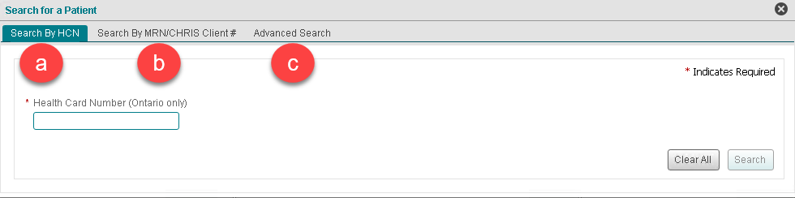


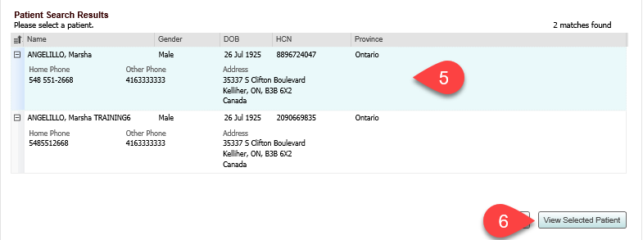


Patient Search
Three ways to search for a patient
To search for a patient:
Select Search for a Patient
Choose a search method:
  Search by HCN (Health Number)
    Use if health number is known
  Search by MRN/CHRIS Client #
    Use if organization name that the
    patient visited and unique patient identification number for that organization are known
  Advanced Search
    For more accurate results, include as much information as possible
    At a minimum, provide first name, last name and either the patient’s date of birth or address (street address and city)
Enter patient identifiers
Select Search
Select desired patient’s name
  To protect the privacy of PHI, a maximum of 5 results displays based on search criteria
Select View Selected Patient
ConnectingOntario ClinicalViewer Trainer’s Guide v14
March 2024
Notes:
Trainer notes:
References:
Train Environment Process pdf
Clinical Viewer User Guide, Find a Patient section
eLearning: Patient Search module
Demo and Live group training methods: demonstrate use of the Patient Search method your organization has identified as preferred based on clinical workflow; use Trainer’s patient “Mabele Zaleski”

Slide 10

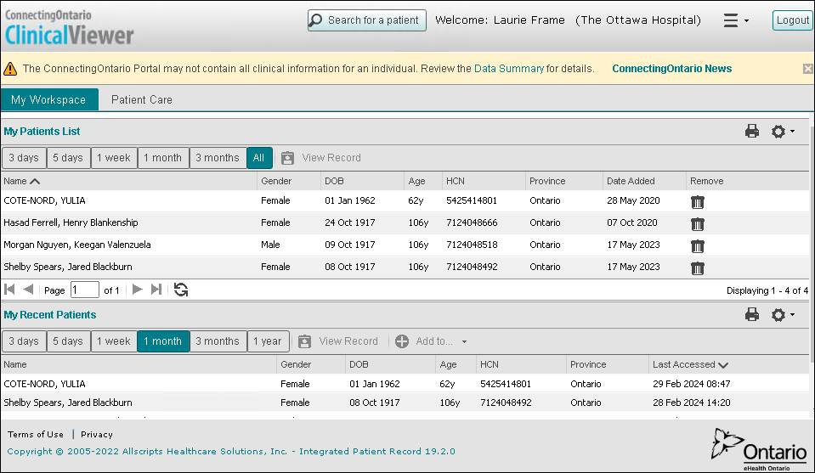


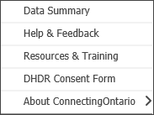
ConnectingOntario ClinicalViewer Window
The ClinicalViewer window has three parts
Header
Always displays, regardless of active tab
Links to the Data Summary (outlines the
types of information, sources and other
details for displayed PHI)
Links to a web page providing updates
/ news about ConnectingOntario such as
release contents, upcoming outage details
Menu containing links to resources
including the Help & Feedback form*
Tabs
My Workspace: displays patient lists
Patient Care: displays PHI for the selected patient
Footer
Always displays, regardless of the active tab
Links to Terms of Use and Privacy resources
* The Help & Feedback form is a fast way to obtain the Ontario Health Service Desk phone number for immediate response to an issue. It also provides an electronic form that can be submitted to Ontario Health to request urgent assistance, suggest an enhancement, or pose a question about a non-urgent issue
Notes:
Trainer notes:
References:
eLearning: Overview module
Demo training method: demonstrate slide content for learners.
Live group training method: have learners follow along as you demonstrate content.
Regardless of training method, it is recommended to cover Data Summary in detail

Slide 11
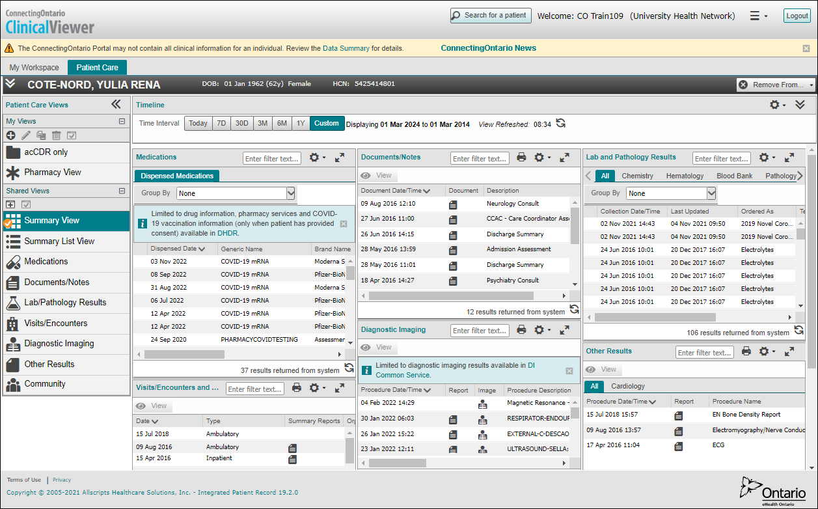
Patient Care Tab
The Patient Care Tab is divided into sections that assist with finding information
Patient Banner
(collapsed view)
Timeline
(collapsed view)
Portlets
(condensed view)
Navigation Bar
(use to change view, launch individual portlets or create custom views)
Notes:
Trainer notes:
References:
Clinical Viewer User Guide, Working with ConnectingOntario ClinicalViewer section
eLearning: Overview and Patient Care Tab Overview modules
Demo and Live group training methods: point at Patient Banner, Navigation Bar, Timeline, and Portlets sections of window. These are the 4 sections of the Patient Care Tab that assist you in finding information on the retrieved patient.

Slide 12
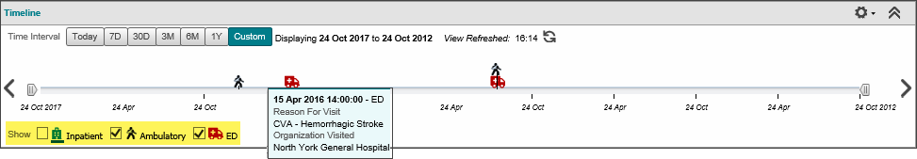
Timeline
The timeline provides a visual snapshot of the patient’s encounters with acute care services over a period of time
Default time interval
Current time interval displayed
Refresh button and time since information last retrieved
Collapse Timeline
Legend for encounter types
Details for an encounter display on the hover
  The timeline displays encounter types from most recent (left) to oldest (right)
  Hover over an icon on the timeline to view details of the visit
  Note: Multiple visits of the same type that are very close to each other in time are represented by a single icon
  The timeline interval setting (i.e., date range) persists through changes in patient selection, but not between browser sessions
ConnectingOntario ClinicalViewer Trainer’s Guide v14
March 2024
Notes:
Trainer notes:
References:
Clinical Viewer User Guide, Clinical Data Components section – Timeline
eLearning: Patient Care Tab Overview module
Demo and live training methods: point out that the date range depicted on timeline is set through use of Time interval buttons and determines date range reflected within all portlets
Default is 30 days; this can be changed in Timeline Preferences – cover if this is important to learners. Remember to reset back to 30 day default
Note: Train patients do not contain data for current time periods. Use the next slide to demonstrate setting a custom time interval for Mabele Zaleski and then demonstrate relationship between the time interval selected, the visual snapshot the timeline provides and hovering over an encounter.

Slide 13

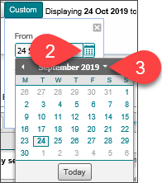
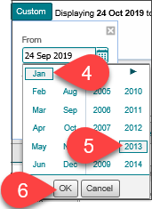
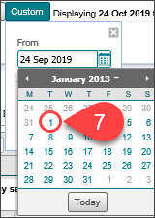
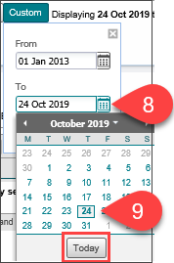
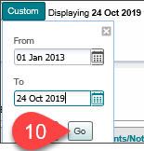
Timeline
Customize the timeline interval to display a date range of your choosing
To customize the Timeline interval:
Select Custom
In the From field, select the Calendar Icon
Select the Down Arrow
Select the desired month
Select the desired year
Select OK
Select the desired day
In the To field, select the Calendar Icon
Select the desired month, year and day
(or select Today)
Select Go
TIP: It is also possible to type dates directly into the From and To boxes, using the format “dd mmm yyyy”
ConnectingOntario ClinicalViewer Trainer’s Guide v14
March 2024
Notes:
Trainer notes:
References:
Train Environment Process pdf
Clinical Viewer User Guide, Clinical Data Components section – Timeline
eLearning: Patient Care Tab Overview module
Demo training method: set custom time interval for Mabele Zaleski of January 1, 2013 to June 30, 2017 following either technique detailed on this slide
Live group training method: following demo, have students complete Amazing Race Leg 1, Questions 1 to 3, using pre-assigned patient of the “Mabele Zaleski” clinical scenario

Slide 14
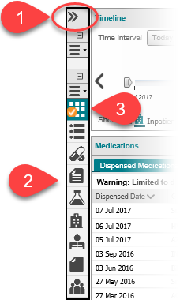
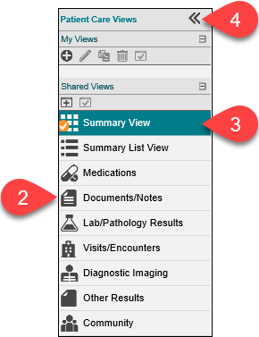

Navigation Bar
The Navigation Bar enables fast switching between different displays of information within the Patient Care tab
Patient information within the portlets can be viewed in several ways:
My Views: customized views that you create
Shared Views
Summary View: grid or 3 column view of all portlets in a condensed format (default)
Summary List View: single column list or “stack” of all portlets in full format (more columns of information)
Individual Portlet View: full screen view of the selected portlet in full format (more columns of information)
Collapsed
Expanded
To select an individual portlet view:
Select the double arrow at the top of the navigation bar to expand it (if it is not already expanded)
Select the desired portlet icon
To return to a summary view:
Select Summary View or Summary List View
Select the double arrow at the top of the navigation bar to collapse it (optional)
To set any view as the default:
Select the desired view (icon) in the navigation bar
Select the default icon
ConnectingOntario ClinicalViewer Trainer’s Guide v14
March 2024
Notes:
Trainer notes:
References:
Clinical Viewer User Guide, Patient Care Views Navigation Bar and Patient Summary Views sections
eLearning: Patient Care Tab Overview module
Demo training method: if time is limited, demonstrate use of individual portlet icons only
Live group training method: demonstrate use of all views (Summary, Summary List, Individual Portlet). Point out option of setting default view.

Slide 15
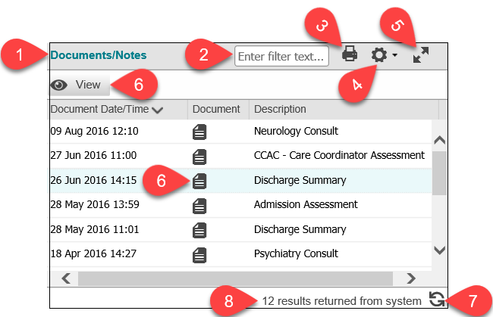
Portlets
The Patient Care Tab displays information for the selected patient during the selected time interval in seven different portlets or windows. All portlets have the same components.
Portlet Title: identifies the type of information available
in the portlet
Filter: display a sub set of records within the portlet by entering one or more terms in this filter box, separating multiple entries with a space. Remove the filter by deleting the entries in the box
Print: enables the printing of all visible entries in the portlet for the currently selected time interval
User Preferences: customize the display of information
Portlet Expander: in both the Summary and Summary List Views, this button expands the portlet to 95% of the screen size. Functionality remains the same as in the Summary/Summary List View. Preferences changed in the expanded view and the overriding of patient consent will apply to the Summary/Summary List View when the expanded portlet is closed
View and Document Icons: display full reports associated with row entries. Reports can be printed
Follow your organization’s policy for printing PHI,
if permitted
Refresh: checks the data repository for new information
Results Count: displays the total number of records in the portlet for the selected time interval
To view a document:
Select the Document icon
OR
Select the row and select View button
Close the document window when finished reviewing
Notes:
Certain document types may have to be downloaded to your computer to view. Follow the instructions within the Document Viewer to download and view. Care must be taken to securely delete the file after use
Multiple documents may be opened and compared for a patient by selecting each document’s icon. Depending on the set up for your internet browser, you may need to select the browser icon on the task bar to display multiple documents
ConnectingOntario ClinicalViewer Trainer’s Guide v09
June 2020
Notes:
Trainer notes:
References:
eLearning: Patient Care Tab Overview module
Cover as much detail here as is pertinent to your organization’s clinical workflow
Demo and live group training methods: using Document/Notes portlet as an example, demonstrate:
use of Print icon
Review your organization’s printing policy with learners
viewing a document using Discharge Summary and either viewing method
Viewing multiple documents – keep Discharge Summary open and open Ambulatory Consult. Also open any document from Visits/Encounters. Minimize the ClinicalViewer window to display all 3 documents. Rearrange/resize the documents on screen so that all 3 are displayed. Review printing of documents and point out/state the first note
Expand – demonstrate / explain use of this button for Document/Notes portlet
While Documents/Notes portlet is expanded, cover Filtering:
In the Filter box type “2013” -> only the results that include this in either Document Date/Time OR Admit Date/Time display
Leave the filter in place and close expanded portlet. Point out that filter is cleared - the portlet is back to the full number of results. Only preference changes and the overriding of patient consent persist between 3 column and expanded portlet views.
Depending on clinical workflow and interest, this is a good place to cover the Status column (Test Result Status in Lab and Pathology Results), available in all portlets except Medications. Details provided in OLIS section. Only Lab and Pathology results display “abnormal” status. Only Final or Amended (indicates revision was made to the document after Final version) results are contributed to ConnectingOntario

Slide 16
Portlets
Portlets, or windows, display specific groupings of information for the selected patient during the selected time interval. There are seven portlets in the ClinicalViewer:
Name | Information
Visits/Encounters and Summary Reports | List of all acute care encounters during the time interval and associated summary reports
Documents/Notes | List of individual documents for non-diagnostic notes and reports Examples: Consultation Notes, Discharge Summaries, History and Physicals, plus community documents not associated with a specific community referral (e.g., RAI assessments, coordinated care plans)
3. Medications | Publicly funded drugs and pharmacy services (including monitored drugs and COVID-19 information) from the Digital Health Drug Repository (DHDR) Displays a list of all medications, by dispensed date, for patients who have a valid Ontario Health Number Detail View shows full details for a selected medication or service
4. Diagnostic Imaging | Displays reports and images from Diagnostic Imaging Common Service (DI CS) provincial repository for each accession Includes all diagnostic modalities submitted to DI CS Amended reports are indicated with red text
ConnectingOntario ClinicalViewer Trainer’s Guide v14
March 2024
Notes:
Trainer notes:
References:
eLearning: Patient Care Tab Overview module
Demo and live group training methods: review information available for Mabele, starting with summary reports in “Visits/Encounters and Summary Reports” portlet and moving to “Documents/Notes”. Explain the difference between the two: Visits/Encounters provides high level summary reports of each visit (encounter) with an acute care hospital whereas Document/Notes provides detailed information on non-diagnostic notes and reports pertaining to those visits plus community documents not associated with a specific community referral – for example RAI assessments and patient care plans
Skip Medications and Diagnostic Imaging for now (they will be covered in detail later on)

Slide 17
Portlets
Portlets, or windows, display specific groupings of information for the selected patient during the selected time interval. There are seven portlets in the ClinicalViewer:
Name | Information
5. Other Results | Reports only (not images) for diagnostic tests that do not appear in Lab and Pathology or Diagnostic Imaging (e.g., respiratory, neurophysiology reports) Cardiology results are grouped and can be viewed in a separate tab
6. Lab and Pathology Results | Information Source: Ontario Laboratories Information System Results are grouped by: Chemistry, Hematology, Blood Bank, Pathology, Microbiology, Other (immunology, serology, allergens) Abnormal results are displayed in red text and flagged: L Below low normal HH Above upper panic limits H Above high normal A Abnormal (applies to non-numeric results) LL Below lower panic limits AA Very abnormal * * (applies to non-numeric units, analogous to panic limits for numeric units) Flowsheet view is available for a predetermined set of common lab test results in a tabular format. Tests available on the flowsheet can be viewed in a trend graph
7. Community | Information from Home and Community Care Services associated with community referrals Contains documents such as: long term care referrals, service and equipment / supplies information
ConnectingOntario ClinicalViewer Trainer’s Guide v14
March 2024
Notes:
Trainer notes:
References:
eLearning: Patient Care Tab Overview module
Demo and live group training methods: continue review of information available for Mabele, covering Community portlet, which displays reports associated with community referrals for care/services (as opposed to broader assessments and overall care plans in Document/Notes)
Skip “Other Results” and “Lab/Path Results” (they will be covered in detail later on)
Live group training method: following the demonstration, have students complete Amazing Race Leg 1, questions 4 to 7

Slide 18
Medications Portlet
Overview of Digital Health Drug Repository (DHDR)
Mandatory Content
The Dispensed Medications tab displays information from the DHDR for Ontarians with an Ontario Health Number. This includes:
Publicly funded drugs (including those listed on the Formulary or approved through the Exceptional Access Program) dispensed in Ontario and paid for by the Ontario Drug Benefit Program (recorded by dispensers using an Ontario Health Number)
Most publicly funded drugs dispensed in Ontario and eligible under Special Drugs Program
Drugs dispensed in Ontario to households pending program eligibility with Trillium Drug Program
Professional pharmacy services provided by a pharmacist in Ontario and paid for by the ministry
Monitored drugs (narcotics and controlled substances), regardless of payor, when the approved identification used was a valid Ontario Health Number, including monitored drugs reimbursed by private insurance or cash
COVID-19 vaccination and testing information documented in COVax_{ON} including information on all COVID-19 vaccines administered in the province as well as COVID-19 testing information, when the test is performed at a community pharmacy. (COVID-19 test results display in the Lab and Pathology Results portlet)
DHDR provides a foundation for the “Best Possible Medication History”, which can be developed with the patient or the patient’s Substitute Decision Maker
ConnectingOntario ClinicalViewer Trainer’s Guide v14
March 2024
Notes:
Trainer notes:
All content in this section is mandatory as directed by the Ministry of Health
References:
COVID-19 Information Tip Sheet pdf

Slide 19

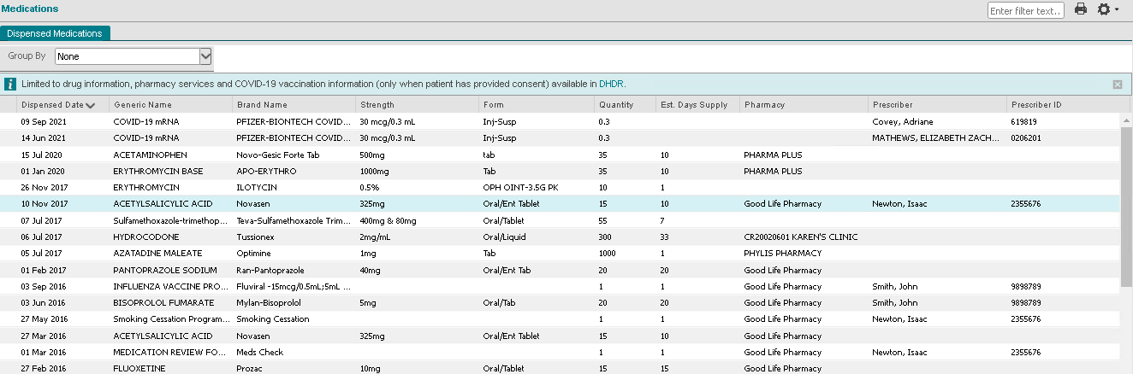

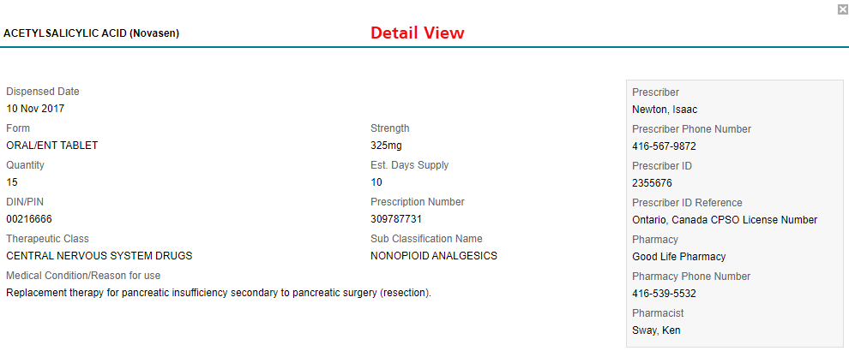
Medications Portlet
Overview
Mandatory Content
Link to Information Available to Health Care Providers through the Digital Health Drug Repository
To view the details for a result:
Select the result
Scroll down to Detail View
The Print function only prints the Dispensed Medications list. Printing of Detail View is not currently available
ConnectingOntario ClinicalViewer Trainer’s Guide v14
March 2024
Notes:
Trainer notes:
All content in this section is mandatory as directed by the Ministry of Health
Demo and live group training methods: review all content with learners
Demonstrate / have learners access link and information provided
Point out that rows with long Generic Name entries are truncated; the column can be expanded by dragging right border of column header
Point out the presence of the Print icon in this view; it was not available for this portlet in Summary View
Demonstrate/ have learners select Print icon
Point out Pharmacy and Prescriber’s phone numbers
Close Print dialog box and Print view
Demonstrate/have learners hover over:
Any Pharmacy name – phone number displays in Hover tip
Prescriber John Smith or Sam Murray – phone number displays in Hover tip (instructor note: not all Prescribers have phone numbers in the Train environment)
Demonstrate/have learners select any row in the Medications portlet
Detail View displays below
Scroll down and review content
Close Detail View

Slide 20
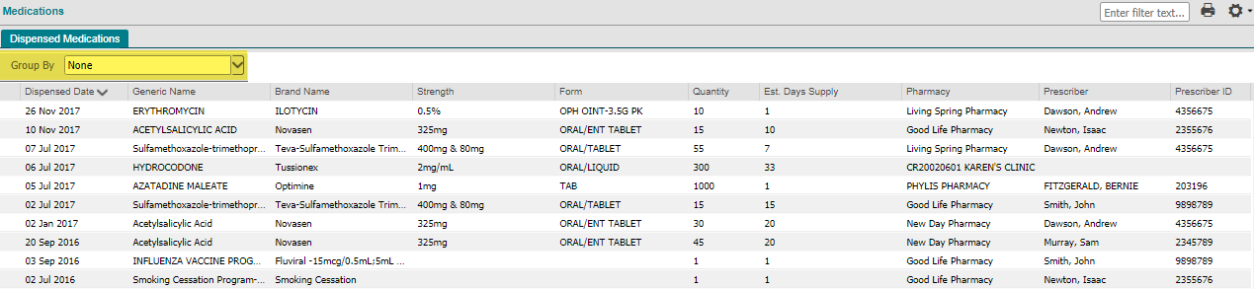
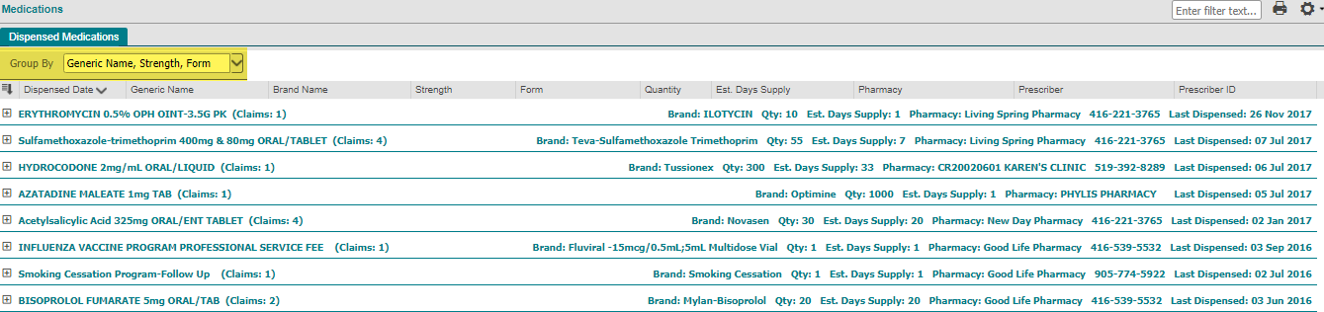
Medications Portlet
You can group the patient’s dispensed medications and provided pharmacy services that have identical generic names, strengths and forms. Grouping summarizes medications / pharmacy services in a way that is useful for medication reconciliation and Best Possible Medication History.
Group By option set to “None” (default)
Group By option set to “Generic Name, Strength, Form”
Group Header (right) displays, for the latest dispensed item in the group, brand name, quantity, estimated days supply, dispensing pharmacy details and date
Group Header (left) displays generic name, strength, form and number of claims (rows) within the group
ConnectingOntario ClinicalViewer Trainer’s Guide v14
March 2024
Notes:
Trainer notes:
Coverage of the grouping feature is optional. It is very useful if learners need to print a condensed list of all of the patient’s medications, without all of the refill detail
Demo and live group training methods: review all content with learners
Still in Medications single portlet view selected previously
Demonstrate / have learners apply grouping
Note: depending on monitor’s resolution and size, it may be necessary to reduce the zoom setting for the browser to display the width of the portlet
All records are now grouped by generic name, strength and form and sorted in order by last dispensed date
# of records contained in the group is summarized on the left side of the grouped header
Right side of grouped header states Brand, Quantity, Estimated Days Supply, dispensing pharmacy name, phone number and date for the last entry only
Point out that the content of grouped headers no longer align with column headings

Slide 21
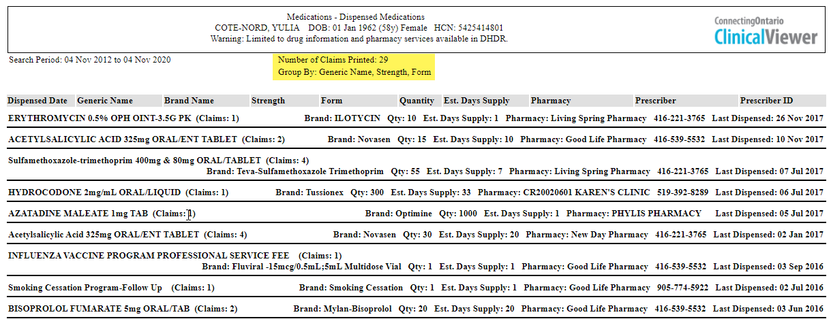
Medications Portlet
Grouping (continued)
When the grouped view is printed, grouping details display in the header
ConnectingOntario ClinicalViewer Trainer’s Guide v14
March 2024
Notes:
Trainer notes:
Coverage of the grouping feature is optional. It is very useful if learners need to print a condensed list of all of the patient’s medications, without all of the refill detail
Demo and live group training methods: review all content with learners
Still in Medications single portlet view selected previously
Demonstrate / have learners select Print icon
Point out grouping addition to header in Print Preview
Point out wrapping of right side grouped headers
Point out reduction in number of pages in the print job
Either close Print Preview or print to pdf/paper, depending on interest/need of learners
Close Print View

Slide 22
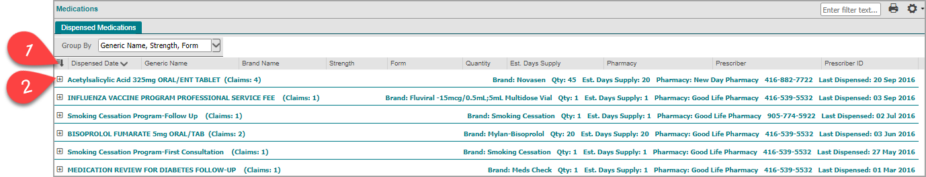
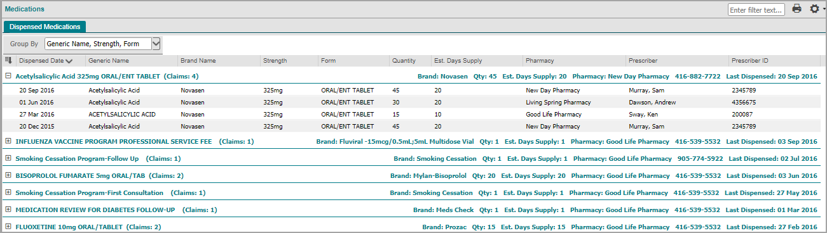
Medications Portlet
Grouping (continued)
Select Expand / Collapse All to expand or collapse all groups
Select Expand / Collapse to expand or collapse individual groups
ConnectingOntario ClinicalViewer Trainer’s Guide v14
March 2024
Notes:
Trainer notes:
Coverage of the grouping feature is optional. It is very useful if learners need to print a condensed list of all of the patient’s medications, without all of the refill detail
Demo and live group training methods: review all content with learners
Still in Medications single portlet view selected previously
Depending on learners’ interest or need:
expand all groups and collapse again
Expand just Acetylsalcylic Acid group and select Print –> group will also be expanded for printing
Change timeline so that it extends from 01 Jan 2015 to 31 Dec 2017
Note: Group By option is reset to “None” whenever the view is refreshed for any reason (timeline change, refresh all data or just for Medications, select a different patient)
Set Group By to “Generic Name, Strength and Form”
expanded group should still be expanded. Although the Group By option is reset; the system remembers expansion at the row level

Slide 23

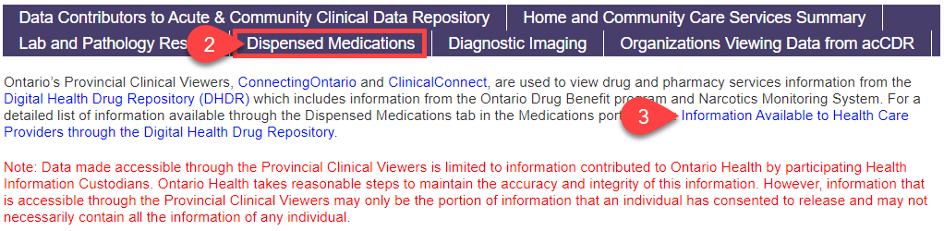
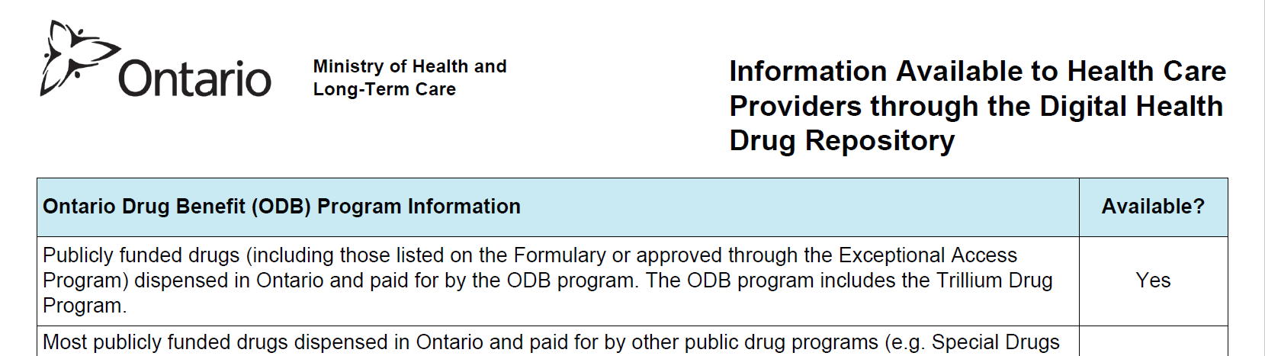
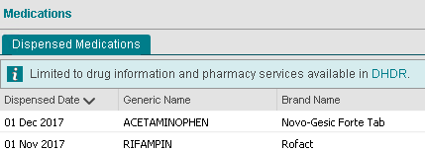
Reference for Dispensed Medications (DHDR)
A listing of information available in DHDR is accessible through the Data Summary or the Dispensed Medications tab
Mandatory Content
  Via Data Summary
  Select Data Summary
  Select Dispensed Medications
  Select Information Available to Health Care Providers through the Digital Health Drug Repository
  Via Dispensed Medications Tab
  Select DHDR
ConnectingOntario ClinicalViewer Trainer’s Guide v14
March 2024
Notes:
Trainer notes:
All content in this section is mandatory as directed by the Ministry of Health
Demo and live group training methods: review all content with learners, if it has not already been covered in Header section (slide 8) and Medication Portlet Overview (previous slide)

Slide 24
Clinical Use of DHDR Information
Limitations of Data - Considerations
Mandatory Content
DHDR information is advisory only and is not intended to replace sound clinical judgment
It may not represent a patient’s complete medication history as it may not include
all the current medications a patient is taking at any time, or
all the pharmacy services that a patient has received
Key considerations include:
the information should be discussed and confirmed with the patient or other source(s)
the patient may not have picked up their medications or may not be taking them as prescribed
the patient may be taking other medications such as over-the-counter or privately-paid medications (excluding narcotics and controlled substances)
it does not include hospital-dispensed medications
it does not reflect details such as:
whether a prescription is new or a refill
changes to drug therapy (e.g., discontinued, dosage)
current use of medication
instructions for use (e.g., frequency)
Contact the dispensing pharmacy or prescriber for additional information or clarification
ConnectingOntario ClinicalViewer Trainer’s Guide v14
March 2024
Notes:
Trainer Notes
All content in this section is mandatory as directed by the Ministry of Health
Demo and live group training methods: review all content with learners
It may be useful to set Group By to “None”

Slide 25
Clinical Use of DHDR Information
Limitations of Data – Important Term Descriptions
Mandatory Content
Dispensed Date: transaction date when the prescription drug was dispensed or the pharmacy service was rendered; it does not indicate if the medication was picked up
Strength: strength of the prescription drug dispensed, amount of active ingredient in the drug; for topical and liquid medication it may be shown as a percentage or ratio
Quantity: quantity of medication dispensed; may be the number of items dispensed, or, for topical and liquid medication (e.g., Methadone), it may refer to dose, total volume or volume of drug concentrate
Estimated Days Supply: estimated days of treatment based on the directions for use on the prescription, and/or the pharmacist’s judgment on usage; estimating usage accurately may not be possible for some prescriptions (e.g., PRN)
ConnectingOntario ClinicalViewer Trainer’s Guide v14
March 2024
Notes:
Trainer notes:
All content in this section is mandatory as directed by the Ministry of Health
Demo and live group training methods: review all content with learners
Either select a medication in the Dispensed Medications portlet and work through these points with learners OR
Display and review the next 2 slides (Slides 25 and 26)

Slide 26
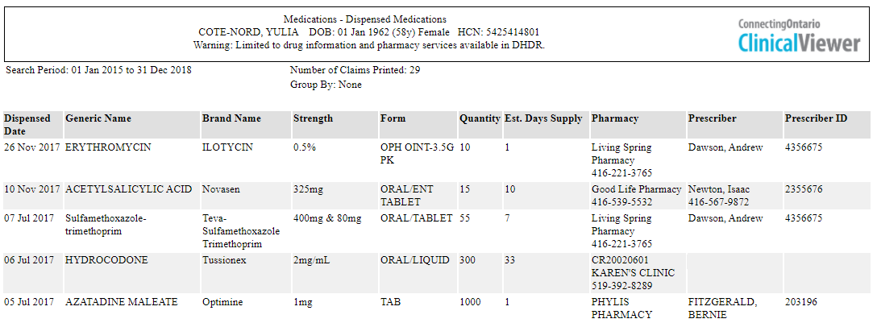
Clinical Use of DHDR Information
Limitations of Data – Clinical Example
Mandatory Content
Example of Printed Medication List
Use caution extrapolating the frequency from the Quantity and Estimated Days Supply
Based on the example above, 90 tablets of Metoprolol 50 mg was filled for an estimated 30 days supply. (Quantity / Estimated Days Supply) = 3 tablets per day. The instructions may have been 75 mg (1.5 tablets) twice a day, 50 mg (1 tablet) three times a day or another variation. Estimated Days Supply may not be accurately estimated, further compounding the problem
ConnectingOntario ClinicalViewer Trainer’s Guide v14
March 2024
Notes:
Trainer notes:
All content in this section is mandatory as directed by the Ministry of Health
Demo and live group training methods: review all content with learners, using either the display of this slide or an entry in Dispensed Medications for current patient

Slide 27
Clinical Use of DHDR Information
Limitations of Data – Clinical Example (continued)
Mandatory Content
Example of Printed Medication List
The DHDR does not indicate if a prescriber intended current use of a medication
The patient may have been instructed to take Metoprolol and Verapamil together, stop one and continue the other, or stop both
Changes to medication therapy are not known
The patient may have been given alternate dosing instructions (e.g., to decrease the Metoprolol dose to 25 mg (0.5 tablet) three times a day)
ConnectingOntario ClinicalViewer Trainer’s Guide v14
March 2024
Notes:
Trainer notes:
All content in this section is mandatory as directed by the Ministry of Health
Demo and live group training methods: review all content with learners, using either the display of this slide or an entry in Dispensed Medications for current patient

Slide 28
Clinical Use of DHDR Information
Limitations of Data – Clinical Example (continued)
Mandatory Content
Example of Printed Medication List
The DHDR reflects an historic record of drug and pharmacy service information. There is no functionality for medications to be marked as discontinued, placed on hold, or to record adverse events or allergies. It cannot be assumed from the appearance of a record that a patient was successfully treated or can tolerate a specific medication
ConnectingOntario ClinicalViewer Trainer’s Guide v14
March 2024
Notes:
Trainer notes:
All content in this section is mandatory as directed by the Ministry of Health
Demo and live group training methods: review all content with learners, using either the display of this slide or an entry in Dispensed Medications for current patient

Slide 29
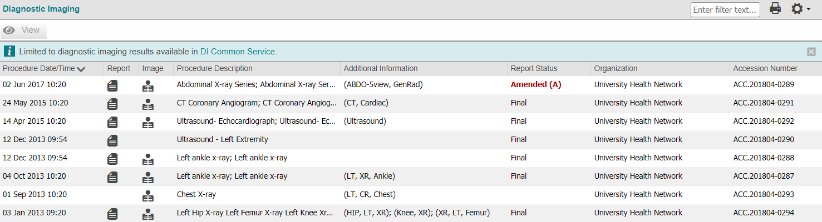
Diagnostic Imaging Portlet
Overview
Access reports as well as images from DI CS
All portlet views display the same information columns
All columns are locked (i.e., columns cannot be hidden)
ConnectingOntario ClinicalViewer Trainer’s Guide v14
March 2024
Notes:
Trainer notes:
Demo and live group training methods: switch to individual portlet view using either DI button on Navigation bar or Portlet Expander

Slide 30
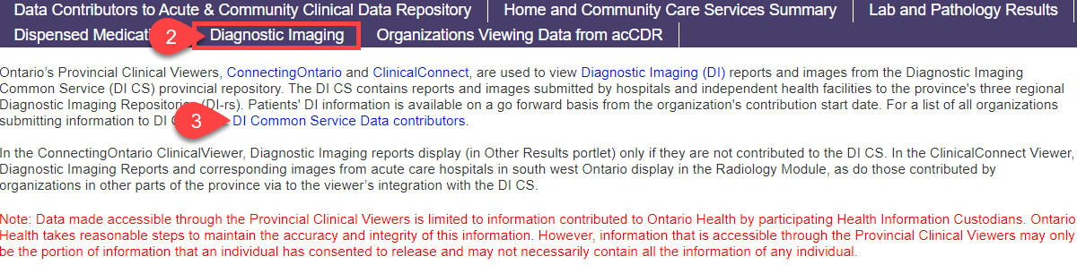
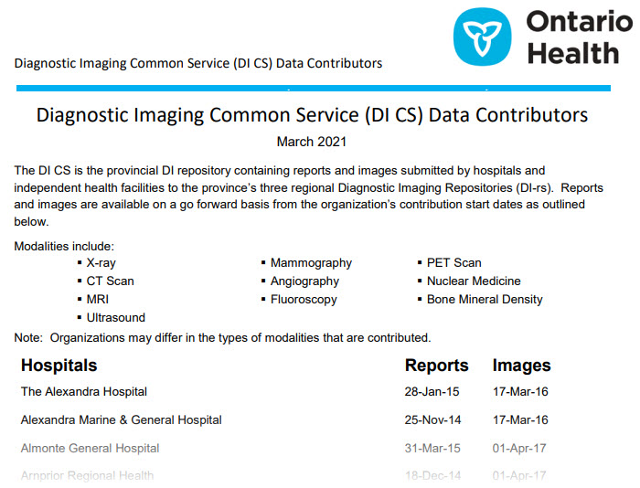
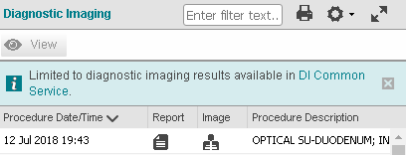

Diagnostic Imaging Portlet: Data Summary
A listing of organizations contributing reports and images to DI CS is accessible through both the Data Summary and the Diagnostic Imaging portlet
  Via Data Summary
  Select Data Summary
Select Diagnostic Imaging tab
Select the DI Common Service Data Contributors link
  Via DI Portlet
  In the DI portlet, select the DI Common Service link to view a current list of organizations contributing to DI CS
Notes:
Trainer notes:
Demo and live group training methods:
Data Summary | DI Contributors - if it has not already been covered in Header section (slide 9), demonstrate/have learners’ practice accessing this info here
Point out that link within DI Portlet displays same information

Slide 31
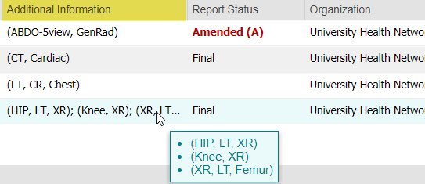
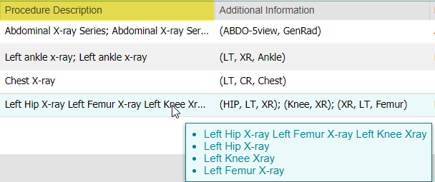
Diagnostic Imaging Portlet
Tips:
Sort in ascending or descending order by selecting the column headers (except for Additional Information). By default, the portlet is sorted by the procedure date and time in descending order
One accession number (row) can be associated with one or more studies. Hover over the Procedure Description or Additional Information columns to view the associated list in a tooltip
Additional information such as modality, anatomic region, and laterality is displayed when provided by the source system
Print the contents of the DI portlet using the Print icon
ConnectingOntario ClinicalViewer Trainer’s Guide v14
March 2024
Notes:
Trainer notes:
References:
DI Viewer User Guide
Demo and live group training methods: demonstrate/have learners’ practice all points on this slide

Slide 32
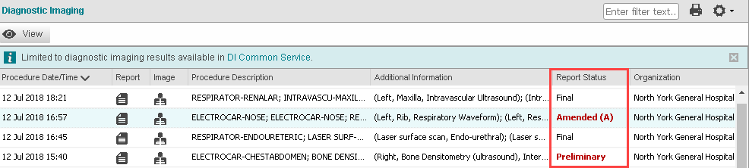


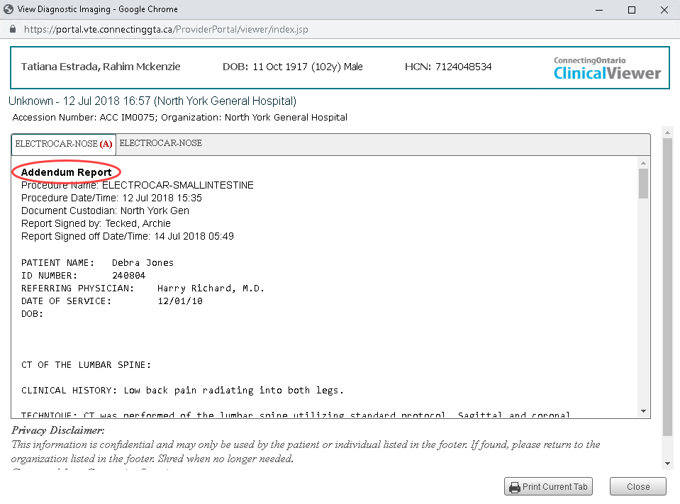




Diagnostic Imaging Portlet
Reports
To view reports:
Select the Report icon in the appropriate row
  The report displays in a separate document viewer window
The status of the report displays in the portlet and in the Document Viewer window
Tips:
Each report is visible in its own tab
Amended reports displayed with a red reporting status label and the Amended label. Note: Amended reports replace the original report, although both display in the Document Viewer
Print the report using Print Current Tab
Close the window using Close or X
ConnectingOntario ClinicalViewer Trainer’s Guide v14
March 2024
Notes:
Trainer notes:
References:
DI Viewer User Guide
Demo and live group training methods:
demonstrate/have learners’ practice opening a DI report. Use 09 Jan 2022; Procedure “Ultrasound-Echocardiograph…”
Note: only this entry contains both a report and an image.
Point out that functionality/structure of document window is the same as seen previously
Keep report open and continue to next slide

Slide 33
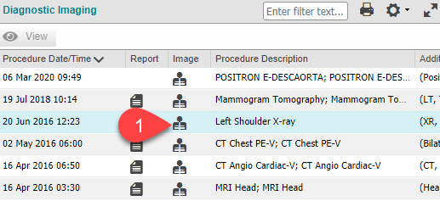
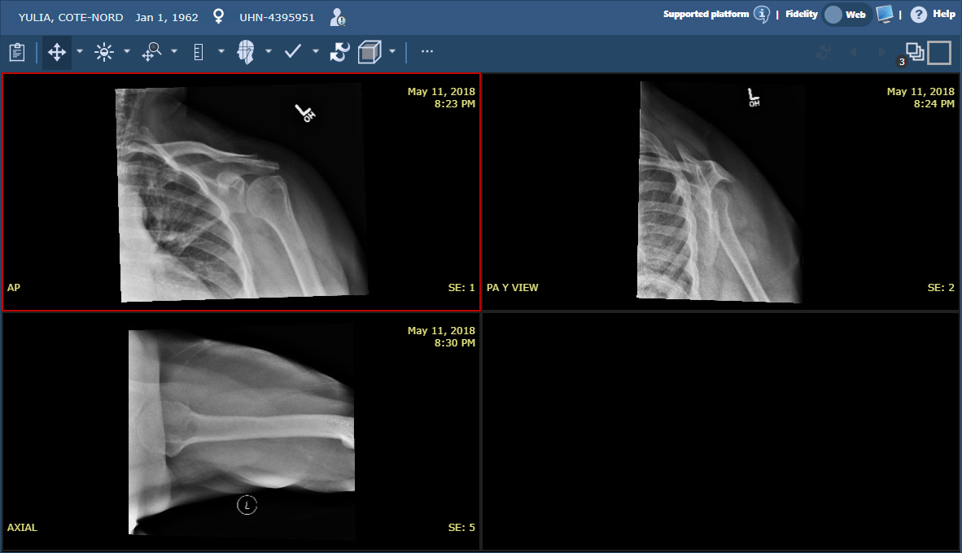
Diagnostic Imaging Portlet
Images
To view diagnostic images:
Select the Image icon in the appropriate row
  The Image Viewer launches in a new window and automatically logs you in
  The Image Viewer displays the image or images for the accession
ConnectingOntario ClinicalViewer Trainer’s Guide v14
March 2024
Notes:
Trainer notes:
References:
DI Viewer User Guide
Demo and live group training methods:
Select image associated with report that is currently open (learners will have to click in the ClinicalViewer window to display it, then select the image)
Point out that a new browser window / tab has opened containing the image
Ensure report is visible (the report window may have to be selected from the browser icon on the Windows Taskbar)
Arrange report and image windows so that contents of both are visible
Leave the windows open; return to the ClinicalViewer window and select a different report/image
Point out that the report has opened in a separate window (total documents now open: 2)
However, the previous image window has closed and a new one, containing the recent selection has opened
It is not possible to have images for different accessions, same patient, open at the same time. It is possible, however, to have different reports from any portlet, for the same patient open at the same time
It is also not possible to have reports and/or images for different patients open at the same time (demo if time – select a different patient either by searching or through My Workspace – all report and image windows open for previous patient will close automatically)
Close all document windows

Slide 34
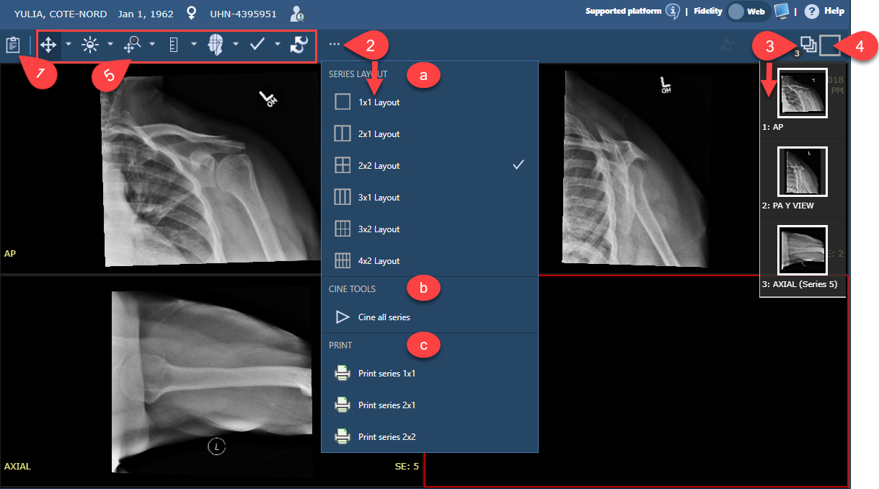
Diagnostic Imaging Portlet
Images (continued)
Tips:
If multiple studies are included in the accession, select Study Information to select another study to view
a) Switch between different layouts
using Options
Cine the series (when applicable)
Print the series
Display the Series Tray to show thumb-
nails of each image in the series. Select a thumbnail to view it
Compare one image to another using Compare Studies
Select from the toolbar to manage the image; hover over a button to display its name
Best Practice: close the Image Viewer window when you are finished viewing images
Selecting another patient within the ClinicalViewer or logging out of the ClinicalViewer closes the Image Viewer
ConnectingOntario ClinicalViewer Trainer’s Guide v14
March 2024
Notes:
Trainer notes:
References:
DI Viewer User Guide
Demo and live group training methods: coverage of this slide is optional, depending on interest / usefulness for learners
If content will not be covered, close image windows

Slide 35
Integration with DI CS
Multiple Locations for Reports
DI reports and images from hospital radiology departments and Independent Health Facilities are contributed to the local DI repository and then DI CS is updated. These reports and images display in the ClinicalViewer, DI Portlet
DI Portlet
DI r
DI CS
Other Results Portlet
DI reports that are not sent to DI CS continue to be contributed to the acCDR. These reports display in the ClinicalViewer, Other Results Portlet
!
Check both the DI and Other Results portlets for DI information
If a procedure is performed at an organization that contributes only to DI CS, information
for the patient will display only in the DI Portlet (no other portlets will be populated)
ConnectingOntario ClinicalViewer Trainer’s Guide v14
March 2024
Notes:
Trainer notes:
References:
DI Viewer User Guide
Demo and live group training methods: this slide explains why different types of DI reports are available in one of two portlets: DI and Other Results
Use the diagram and information below to review with learners
Important points to note regarding integration with DI CS:
Depending on the workflow of the contributing hospital, some DI reports are still contributed to the acCDR and will display in the Other Results portlet, either tab
Scenario 1 BMD’s (bone mineral density) can appear in DI or Other Results, All tab, depending on the workflow of the hospital
Scenario 2 Echo (ultrasound echo cardiograph) can appear in DI or Other Results, Cardiology tab
Scenario 3 Ultrasound performed in the ED of a local hospital is not sent to DI CS and therefore displays in Other Results portlet, All tab
All of these scenarios are examples of procedures that may be performed in departments other than Radiology. Therefore, the results will be contributed to acCDR not DI CS.
Organizations may contribute to DI CS but not to CDR, e.g. IHFs (Independent Health Facilities). Refer to the list of contributing sites available through the Data Summary for more details - there may be DI CS information available for viewing even though there is no other information displayed in the rest of the ClinicalViewer. E.G.: a patient who has a DI procedure performed at an IHF and has never been admitted to a hospital. Only DI CS would have data for this patient, not acCDR.

Slide 36
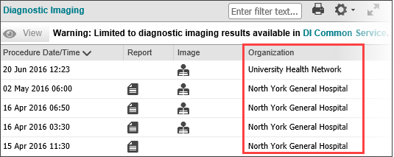
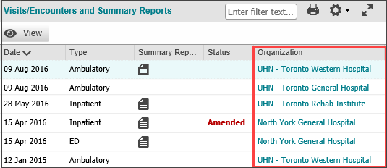
Integration with DI CS
Organizations and Facility Names
The coding approach at each contributing organization determines what displays in the Organization column within the ClinicalViewer: organization only or organization plus facility. This results in differences between how the same organization is listed in the DI portlet and all of the others:
ConnectingOntario ClinicalViewer Trainer’s Guide v14
March 2024
Notes:
Trainer notes:
References:
DI Viewer User Guide
Demo and live group training methods: select Summary View for current patient
Visits/Encounters and Summary Reports: scroll right to display Organization column; good opportunity to demo/practice resizing columns (by dragging right border of column headings) to display Organization column
Diagnostic Imaging: scroll right to display Organization
Point out difference in content and explain that difference is due to the coding approach at contributing organizations (as per slide content)

Slide 37
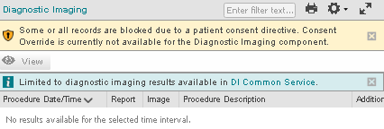
Diagnostic Imaging Portlet
Consent
The message outlined in red below indicates that data in DI CS has been blocked due to a consent directive
It is not possible to override consent blocks in the DI portlet nor to retrieve blocked data stored in DI CS
ConnectingOntario ClinicalViewer Trainer’s Guide v14
March 2024
Notes:
Trainer notes:
References:
DI Viewer User Guide
Demo and live group training methods: patients have the right to block the display of any and all of their personal health information in the ClinicalViewer
Should a patient block their DI content, it is not possible for a health care provider to override that block
Consent override is only available for content in the other portlets
Live group training method: have learners complete Amazing Race Leg 2

Slide 38
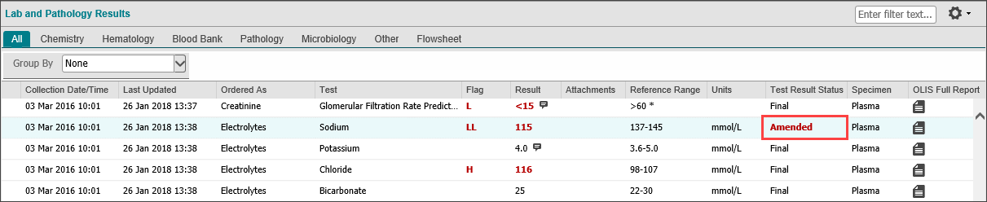
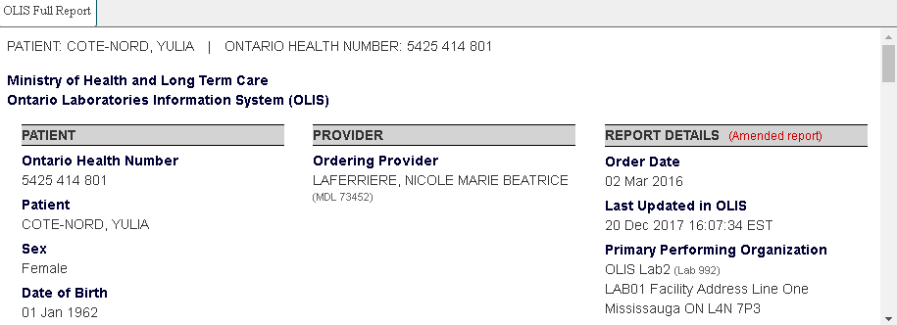
Lab and Pathology Results: Amended Results
An Amended result is a test that was at “Final” status and was then revised
Report displayed in Document Viewer:
ConnectingOntario ClinicalViewer Trainer’s Guide v14
March 2024
Notes:
Trainer notes:
References:
ConnectingOntario Clinical Viewer User Guide, Lab and Pathology Portlet
Demo and live group training methods: modify coverage of this portlet depending on learners’ interest and need
Consent Override will be covered in next section
Switch to individual portlet view by either selecting Lab/Pathology Results icon in Navigation Bar or Portlet Expander
Point out absence of Print icon in portlet header – due to the nature of the information, the ability to print the listing of the portlet’s content is not useful
Rather, each row in the portlet contains an OLIS Full report icon – this report is printable and contains all findings related to a row entry (demonstrate/have learners try)
Also due to the nature of the content of this portlet, multiple tabs are used to display content. Each tab includes generally the same columns, with a few exceptions depending on the tab. Depending on learners’ interests and needs, demonstrate/have learners try.
Note: not all tabs are populated for patients in Train
OLIS Full Report: provides full, detailed results from the lab on all tests performed on the specimen
Blue callout icon: hover over this icon to display lab comments for a test result
Attachments column: displays an icon when there is an attachment related to the result
Return to All tab
Note:
The maximum number of lab results displayed is approximately 1000
If more results are available for a patient within the selected timeframe, a subset of those results will display along with a warning indicating that the maximum number of results has been reached
Reduce the date range on the timeline.

Slide 39


Lab and Pathology Results: Invalid Results
An Invalid result is a test that was incorrectly entered on the wrong patient and has been removed
Detail View:
ConnectingOntario ClinicalViewer Trainer’s Guide v14
March 2024
Notes:
Trainer notes:
References:
ConnectingOntario Clinical Viewer User Guide, Lab and Pathology Portlet
Demo and live group training methods:
Demonstrate/have students perform a filter to show only those results that have an Amended Test Result Status (hover over Test Result Status column header, select Down Arrow that displays, hover over “Filters” and click in box beside “Amended”)
Explain that Amended results are tests that were at “final” and were then revised
Select any row with an Amended Test Result Status and scroll down to examine Details Screen; either close or scroll up when done
For the same row, open the OLIS Full Report and scroll through to discover the specific results that were revised; close the report and clear the filter

Slide 40


Lab & Pathology Results: Flowsheets & Trend Graphs
Trending graphs can be displayed for results available from the Flowsheet
To graph results:
Check the boxes beside the results that you want to graph
Select Graph
Hover over data points to review the details of a given result. Blue dots are normal results, red dots are abnormal
Note:
Only numeric values can be included in a trend graph
ConnectingOntario ClinicalViewer Trainer’s Guide v14
March 2024
Notes:
Trainer notes:
References:
ConnectingOntario Clinical Viewer User Guide, Lab and Pathology Portlet
How to Use the Lab and Pathology Portlet tip sheet
Demo and live group training methods: current patient
Select Flowsheet tab – define and review
The flowsheet trends lab results for commonly ordered tests over the selected timeline. These results are displayed in four panels within the Flowsheet tab: Hematology, General Chemistry, Lipid Profile, and Liver Panel/Pancreas Panel. It is not possible to add additional tests to what is presented.
Graphing of these results is also possible:
Select 2 tests, for example: HbA1C (General Chemistry), and Cholesterol (Lipid Profile) – or any results of interest to learners
Select Graph, review plotted graph and try Graphing options
Close Lab and Pathology Results expanded view
Explain that any changes made while in individual portlet view do not persist when another view is selected – unless the changes are to the portlet’s preferences
Live group training method: have learners complete Amazing Race Leg 3

Slide 41

Consent Management
A patient can withhold consent for the viewing of their personal health information by putting in place a consent directive on all or some of their health record
1. Indicates that a Consent Directive has been applied to some/all Acute Care encounters in the selected date range
2. Indicates that a Consent Directive has been applied to some/all information in the portlet for the selected date range
Temporary consent override is available in all portlets (except Diagnostic Imaging)
Informed and express consent from the patient or substitute decision maker is required for the unblocking of any PHI. A signed hard-copy express consent form is required when unblocking Dispensed Medications information
If you override a consent directive, the privacy officer at your organization will be informed of the activity and the patient will be notified
All activity in the ClinicalViewer is tracked and is auditable
Refer to the Privacy and Security Information tip sheet for best practice reminders
ConnectingOntario ClinicalViewer Trainer’s Guide v14
March 2024
Notes:
Trainer notes:
Reminder: do not complete a consent override in the Train environment on patient’s Lab/Path results as it will be overridden for 4 hours to all users of the environment
References:
ConnectingOntario Clinical Viewer User Guide, Overriding Consent
COVID-19 Information Tip Sheet
Demo and live group training methods: Instructor: retrieve Mabele Zaleski (My Workspace, Recent Patients) if necessary
Demonstrate only (do not have learners practice) the details around consent override as outlined in these slides
Consent Override Notes:
The Consent Override banner displays on the timeline ONLY when the patient has placed a consent block on Acute Care encounters included in the selected date range. If the patient has only blocked information displayed in the Medications, Lab and Pathology Results, and/or DI portlets, a Consent Override banner will not display on the timeline.
When a consent directive is overridden, the patient, the Privacy Officer at your organization, and Ontario Health are informed
There are only 4 circumstances under which a consent directive may be overridden: (1) express consent received from patient, (2) express consent received from the Substitute Decision Maker, or in the event of significant risk of bodily harm to (3) the patient or (4) another person
When an express consent override is performed, it acts as a universal override and will result in ALL portlets with a consent directive being unblocked
This is important to remember because an override on the Dispensed Medications tab requires the completion of a consent form, even if you don’t require the information
The completed and patient-signed consent form must be retained as part of the patient’s record
Risk of Harm override will not unblock Lab and Pathology or Dispensed Medications
It is not currently possible to unblock a consent directive on the DI portlet under any circumstances
If a patient has blocked access to their COVID-19 vaccination information, administration of the vaccine is not entered into the repository by the administering health care provider. Therefore, it will not display in the Medications portlet under any circumstances

Slide 42
Consent Management (continued)
A patient can withhold consent for the viewing of their personal health information by putting in place a consent directive on all or some of their health record
An express consent override in the ClinicalViewer results in all portlets with a consent directive being unblocked (except Diagnostic Imaging)
Although the data in the Dispensed Medications tab may not be required to provide care, an express consent override in another portlet will also release this data and you must complete the express consent form in addition to the Consent Override dialogue box
Risk of Harm overrides will not unblock information in the Lab and Pathology portlet or Dispensed Medications tab
ConnectingOntario ClinicalViewer Trainer’s Guide v09
June 2020
ConnectingOntario ClinicalViewer Trainer’s Guide v14
March 2024

Slide 43
Consent Management (continued)
Before performing an express override on any portlet in the ConnectingOntario ClinicalViewer:
Confirm if a block is placed on the Dispensed Medications tab. If it is blocked, you must print a hard-copy express consent form. This can be obtained from the Consent Directive dialog box
Inform patient or substitute decision maker:
of the reason for overriding consent
that the override will apply to any other information or portlet where a block has been applied
that they may refuse to permit the override
that the information will be available:
Data Source | Duration & Users Who May Access
Acute and Community Clinical Data Repository (All portlets except Lab and Pathology, Medications - Dispensed Medications and Diagnostic Imaging) | Up to 11:59 pm on the day that the override was initiated to the user that requested the override
Ontario Laboratories Information System (Lab and Pathology Portlet) and Digital Health Data Repository (Medications - Dispensed Medications) | Available for 4 hours to all users at the organization or practice where the override occurred
If the patient agrees to the override and the Dispensed Medications tab is blocked, obtain consent and document its receipt by requesting a signature from the patient or substitute decision maker on the express consent form and complete the Consent Directive dialogue box
ConnectingOntario ClinicalViewer Trainer’s Guide v14
March 2024

Slide 44




Consent Management (continued)
When a consent block is in place, a banner containing a message and the Override Consent button displays
To override a consent directive:
After obtaining informed consent from the patient or substitute decision maker (SDM) (as applicable):
Select Override Consent
Select the circumstance that applies
For the first and second choices, if a block is in place on Dispensed Medications, select consent form to print the hard-copy consent form and obtain signature from the patient or SDM
For the second choice, complete SDM information
The third and fourth choices, Significant Risk of Bodily Harm, is not a condition for overriding blocked lab and pathology results (OLIS) or dispensed medications data (DHDR). If this is selected, the Lab and Pathology Results portlet and Dispensed Medications tab in Medications portlets will not be unblocked
Select Override Consent and View Patient Record
The patient’s information displays with a
message that information was previously blocked
Indicates that a Consent Directive has been applied
ConnectingOntario ClinicalViewer Trainer’s Guide v14
March 2024

Slide 45

Consent Management (continued)
When a patient places a consent directive on all records, the patient can be found in the ClinicalViewer, but no information displays in the portlets
It is not possible to override consent blocks in the DI portlet or
to retrieve blocked data stored in
DI CS
When a consent override is in place, a message appears within each unblocked portlet to inform users of the impact and conditions of viewing blocked information
ConnectingOntario ClinicalViewer Trainer’s Guide v14
March 2024

Slide 46

Consent Management: COVID-19 Information
If a patient has blocked access to their DHDR records and COVID-19 vaccination records are available for that patient, the COVax_{ON} record will also be blocked
When a patient/SDM’s consent with signature is obtained and a temporary consent override is performed, all available DHDR and COVax_{ON} information is unblocked
However, at the time of COVID-19 vaccination, if a patient does not consent to share their information, it is not entered into COVax_{ON}. Therefore, a record of the vaccination is not available in COVax_{ON} or DHDR
ConnectingOntario ClinicalViewer Trainer’s Guide v14
March 2024

Slide 47

ConnectingOntario ClinicalViewer
Available Training Resources
Additional information such as elearning modules and tip sheets are available:
From Resources & Training in the menu
From the Client and End User Support sections of
the ConnectingOntario ClinicalViewer Support page
By contacting your organization’s trainer, clinical
champion or super user
By contacting oh-ds_connectingontario@ontariohealth.ca
ConnectingOntario ClinicalViewer Trainer’s Guide v14
March 2024

